Slide 2
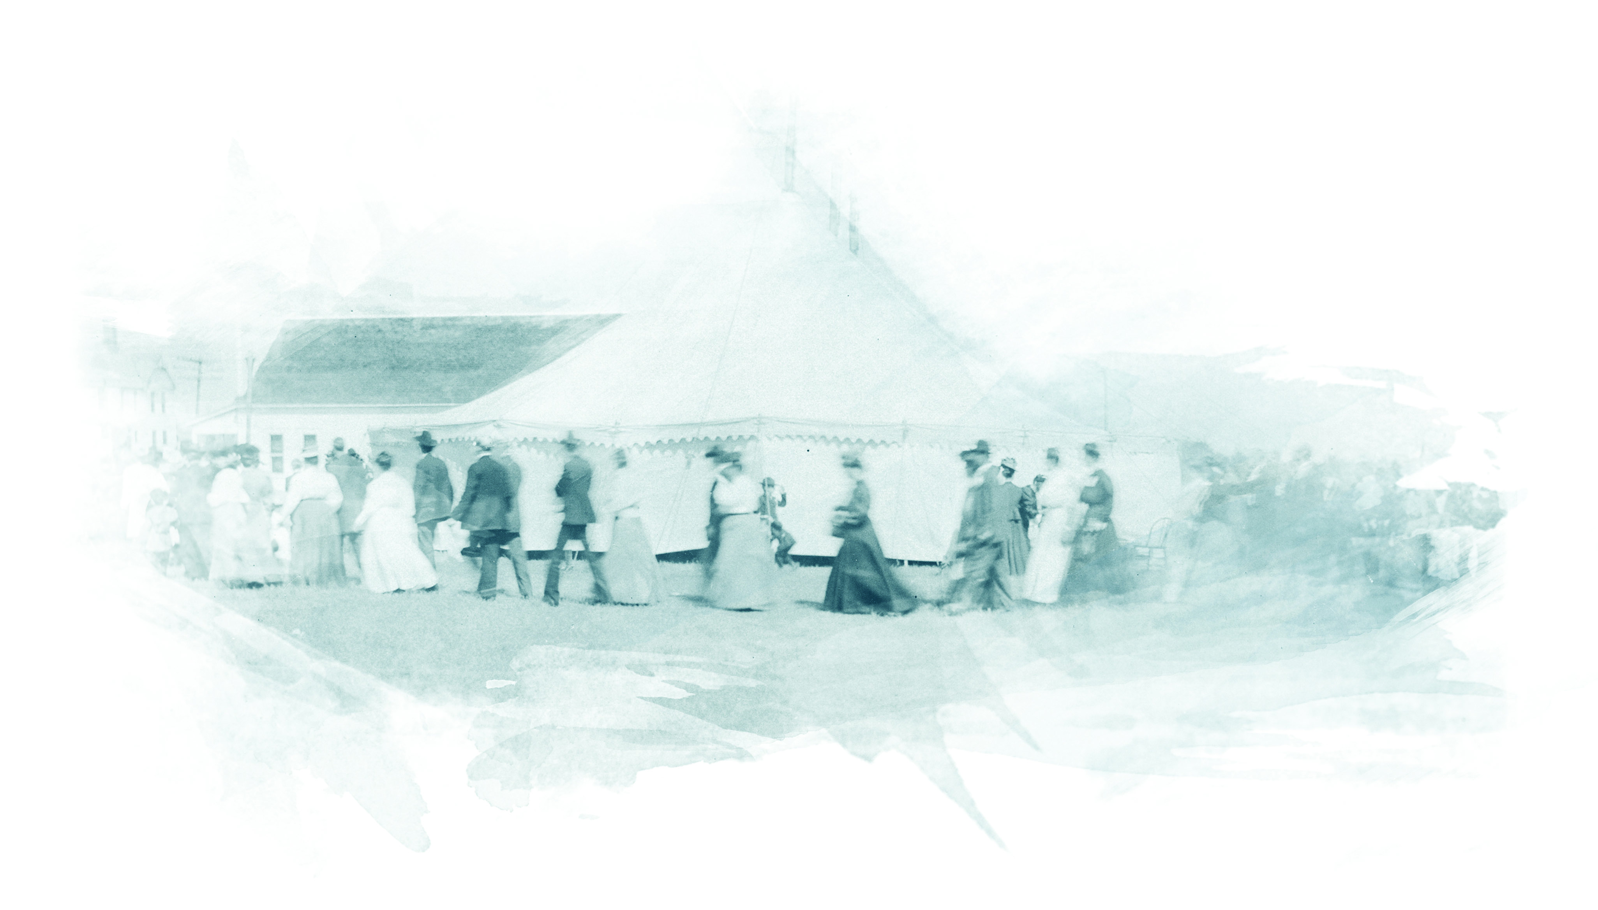
our Heritage

Slide 3
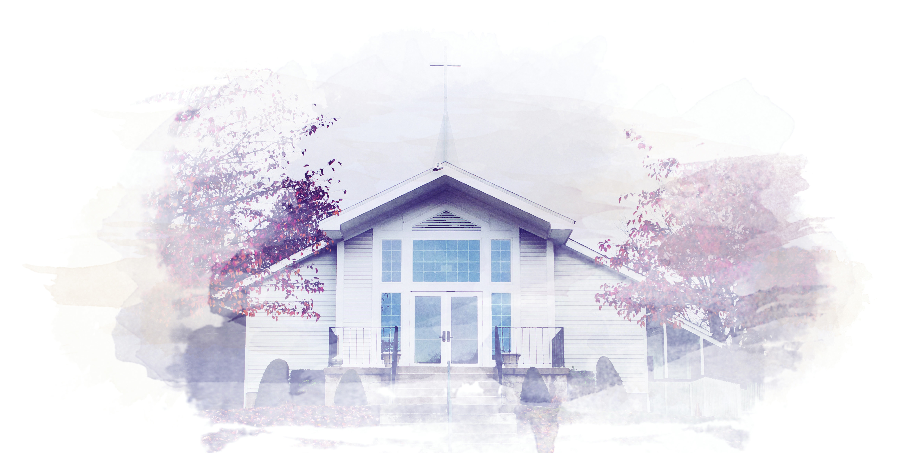
we are a Christian people

Slide 4
Ephesians 2:17-22
¹⁷ He came and preached peace to you who were far away and peace to those who were near.

Slide 5
Ephesians 2:17-22
¹⁸ For through him we both have access to the Father by one Spirit.

Slide 6
Ephesians 2:17-22
¹⁹ Consequently, you are no longer foreigners and strangers, but fellow citizens with God’s people and also members of his household,

Slide 7
Ephesians 2:17-22
²⁰ built on the foundation of the apostles and prophets, with Christ Jesus himself as the chief cornerstone.

Slide 8
Ephesians 2:17-22
²¹ In him the whole building is joined together and rises to become a holy temple in the Lord.

Slide 9
Ephesians 2:17-22
²² And in him you too are being built together to become a dwelling in which God lives by his Spirit.

Slide 10
we are a Christian people

Slide 11
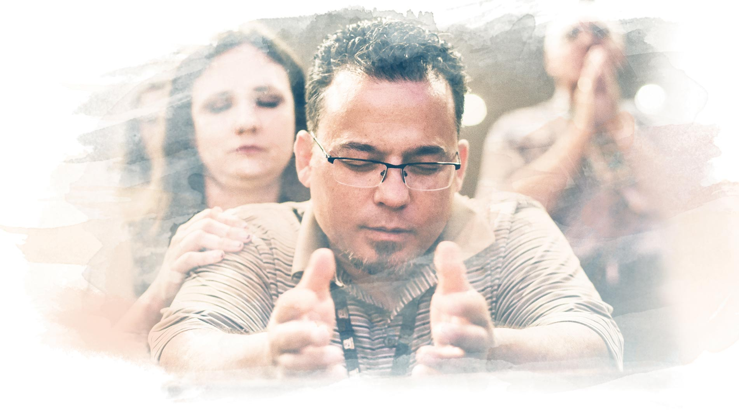
we are a Holiness people

Slide 12
Ephesians 5:1-2
¹ Be imitators of God, therefore, as dearly loved children

Slide 13
Ephesians 5:1-2
² and live a life of love, just as Christ loved us and gave himself up for us as a fragrant offering and sacrifice to God.

Slide 14
we are a Holiness people

Slide 15
we are a Missional people

Slide 16
Matthew 28:18-20
¹⁸ Then Jesus came to them and said, “All authority in heaven and on earth has been given to me.

Slide 17
Matthew 28:18-20
¹⁹ Therefore go and make disciples of all nations, baptizing them in the name of the Father and of the Son and of the Holy Spirit,

Slide 18
Matthew 28:18-20
²⁰ and teaching them to obey everything I have commanded you. And surely I am with you always, to the very end of the age.”

Slide 19
we are a Missional people

